Slide 1

Fine-Tuning Models Part 3

Slide 2
What We Will Cover
Understanding Pre-Training
Understanding Fine-Tuning
When to Use Fine-Tuning
Preparing Training Data
Cost Calculations
Train / Test Split
Creating Fine-Tuning Jobs
Analyzing the Training Metrics
Exploring Fine-Tuning Jobs
Understanding Checkpoints
Exploring Fine-Tuning Events
Using Fine-Tuned Models
Fine-Tuning Use Cases
Integrations

Slide 3
Cost Calculations

Slide 4
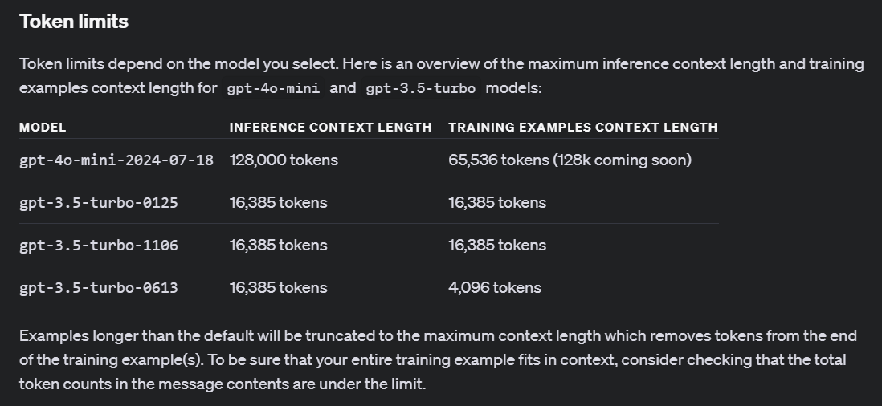
Notes:
https://platform.openai.com/docs/guides/fine-tuning/token-limits

Slide 5
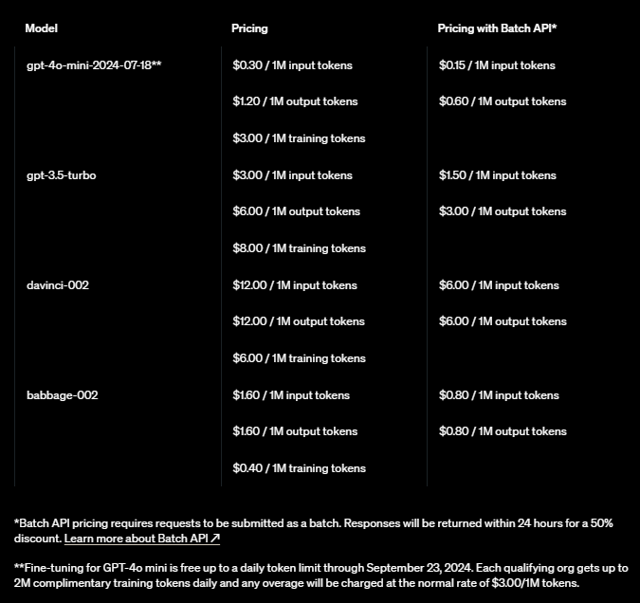
Notes:
https://openai.com/api/pricing/

Slide 6
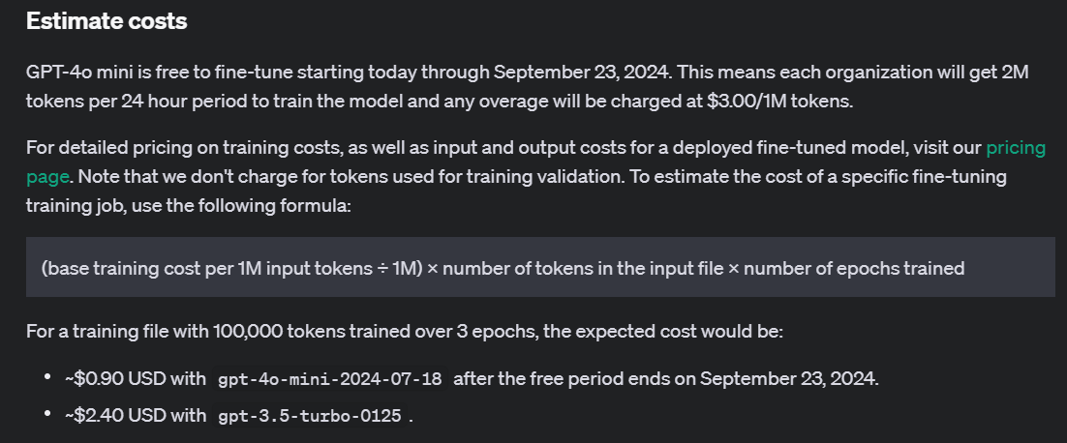
Notes:
https://platform.openai.com/docs/guides/fine-tuning/estimate-costs

Slide 7
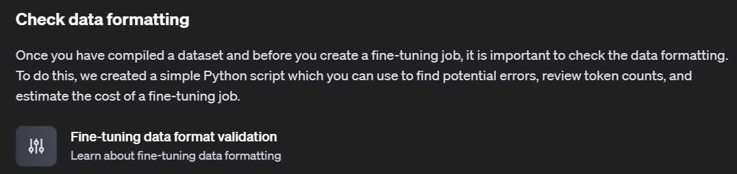
Notes:
https://platform.openai.com/docs/guides/fine-tuning/check-data-formatting

Slide 8
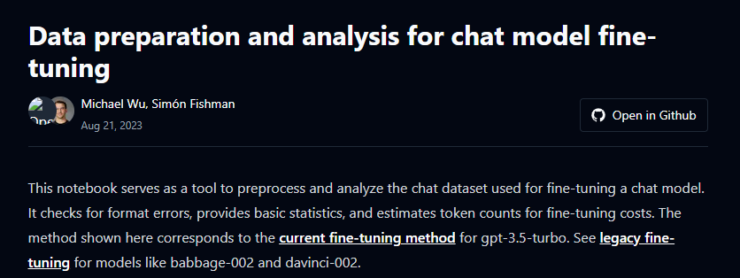
Notes:
https://cookbook.openai.com/examples/chat_finetuning_data_prep

Slide 9
Demo: Training Files Validation & Metrics
# Define the path to the dataset file
data_path = "./artifacts/marv_fine_tune.jsonl"
# Load the dataset
with open(data_path, 'r', encoding='utf-8') as file:
dataset = [json.loads(line) for line in file]
# Print initial dataset statistics
print("Number of examples:", len(dataset))
print("First example:")
# Print messages from the first example in the dataset
for message in dataset[0]["messages"]:
print(message)

Slide 10



Notes:
https://www.youtube.com/channel/UC35ZpwldGw7ZJ5R-2sLijzw

Slide 11
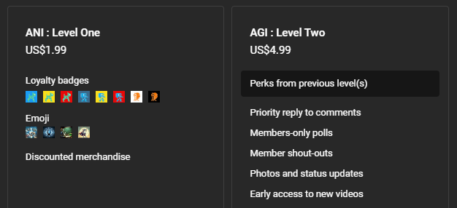
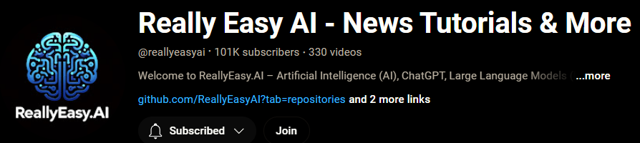
Membership has its privileges
Notes:
https://www.youtube.com/channel/UC35ZpwldGw7ZJ5R-2sLijzw/join

Slide 12

https://www.youtube.com/@AINewsFresh

Slide 13


